Slide 1
Using Zero Shot Classification on Financial News Headlines
Dylan Viswambaran

Slide 2
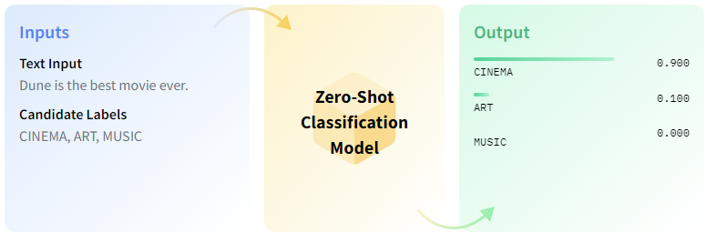
Overview
What is Zero Shot Classification?
Zero-shot text classification is a task in natural language processing where a model is trained on a set of labelled examples but is then able to classify new examples from previously unseen classes.
Notes:
As shown in the example above – there are two inputs into the model – Text Inputs and Candidate Labels – Both of which are provided by the user. This is fed into the zero shot classification model and it will then classify the text input into the labels provided. In this case you can see the output on the right where Cinema was given a 90% probability of being the label that represents the text input.
1. Word Embeddings:
What it is: Word embeddings transform words into vectors in a high-dimensional space. This space is designed so that words with similar meanings are closer to each other.
How it works: Using models like Word2Vec, GloVe, or FastText, each word in a vocabulary is assigned a unique vector. The position of the vector captures semantic information about the word. For example, in this space, the vectors for "king" and "queen" might be closer to each other than the vectors for "king" and "apple", reflecting their semantic relationship.
Why it's important: By converting words into vectors, we can mathematically represent and compare their meanings, which is foundational for many NLP tasks.
2. Contextual Understanding:
What it is: Modern transformer models, like BERT, GPT, and their variants, not only consider individual words but also the context in which they appear.
How it works: Transformers use self-attention mechanisms to weigh the importance of different words in a sentence relative to a particular word. This means that the word "bank" in "I sat by the river bank" and "I went to the bank" would have different embeddings, reflecting the different contexts.
Why it's important: Many words have different meanings based on context. Recognizing these nuances is crucial for accurate language understanding and subsequent tasks like classification.
3. Projection Space:
What it is: For zero-shot classification, both the text embeddings and potential class labels are represented in a shared space where their relationships can be compared.
How it works: Typically, the embeddings of the text and the potential class labels are projected into this space. The similarity (or distance) between the text and each class label is computed. One common method is cosine similarity, which measures the cosine of the angle between two vectors. A smaller angle (and thus a higher cosine similarity) indicates that two vectors are more similar.
Why it's important: By comparing the text to each potential class label in this shared space, we can determine which class is the most appropriate or relevant, even if the model has never seen that class during training.
4. Classification:
What it is: The final step where the model assigns a class label to the input text.
How it works: The class label with the highest similarity (or the shortest distance) to the text embedding in the projection space is chosen as the output.
Why it's important: This step provides the final output for the task at hand, allowing us to categorize or classify the input based on the model's understanding.

Slide 3
Why use Zero Shot Learning?
Adaptability to new classes
Ability to classify data into categories that were not present during the training phase (of the initial model)
Cost Efficiency
Data Efficiency
Notes:
One of the most significant advantages of zero-shot classification is its ability to classify data into categories that were not present during the training phase. This adaptability is crucial in dynamic domains where new classes can emerge over time.
Cost efficient - Continuously collecting and annotating data for new classes can be expensive and time-consuming. Zero-shot classification can reduce the need for such efforts, making it more cost-effective in the long run.
Data efficiency - In situations where there's limited labeled data available for certain classes, zero-shot classification can still perform effectively, making the most of the available information.

Slide 4
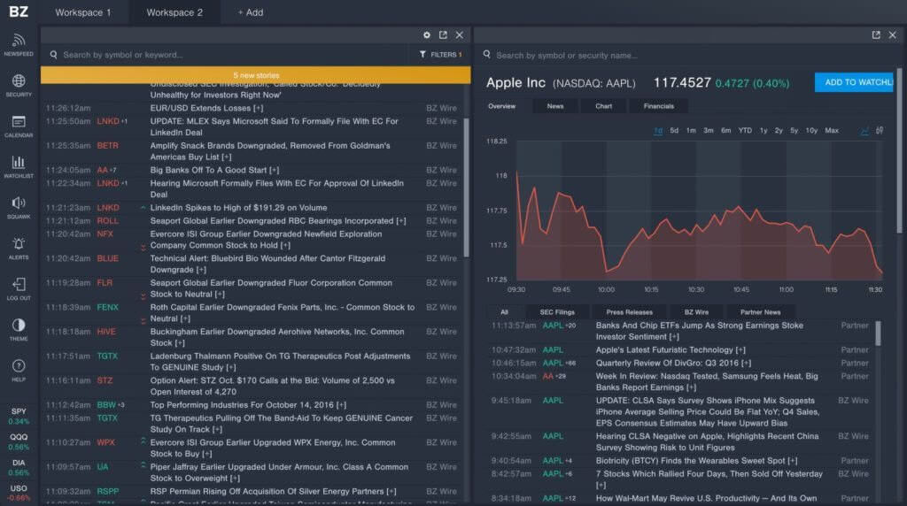
How can this be applied to Financial Data within the organisation?
The Prudential Regulation Authority is responsible for the safety and soundness of the firms it regulates, focusing on the adverse effects that they can have on the stability of the UK financial system.
One way to monitor firms is via News feeds
Notes:
this can provide crucial information on events affecting firms which may be of interest to supervisors when considering any potential supervisory intervention.
Using a zero shot model would provide a reliable method of sifting through millions of news articles to identify those of particular interest.
Given the ZSL model is capable of classifying text without being trained on it makes it highly accessible for us here to quickly label article headlines into appropriate risk categories – namely Credit, liquidity, markets, operational and generic risk – amongst other terms of interest such as fines frauds etc.

Slide 5
Implications
Expertly defined labels
Changes to labels over time – how to link these to historic labels?
Computational power
Notes:
Firstly the domain specialists needs to agree on what labels they would want to use to classify labels – these should agree with majority of supervisors to ensure that the best labels are used to prevent further disagreements on what an article should be labelled and whats of relevant interest. If too many labels are provided to the model – Whilst it can be set to multi label it can lead to articles being mislabelled and therefore not actually streamlining the process.
Secondly – as time goes on so to topics and trends – what might be useful now (credit/market/fraud etc) might not be of interest in the future and as such the labels will need updating – however if the labels have changed but have close similarities – how can you link the present and past to see historical articles?

Slide 6

Recommendations
Explore Few shot classification / Using FinBERT
Cloud Computing
Bi-annual Model Review
Notes:
- Few shot classification – Having explored ZSL which is a great way to classify an article – in many cases the confidence scores are quite low and there is still a chance of misclassification which can lead to the business losing confidence in the tool and as such few shot classification could help improve there – tthis is where there is a limited number of labeled examples for each new class. The goal is to make predictions for new classes based on just a few examples of labeled data. So given a few examples which requires some manual labelling it can potentially provide better labels.
Cloud computing using platforms such as Azure and AWS can give significant computing power which is typically needed for such processes given its computationally power needed to run these models. Processing these locally can take an extremely long time – this increases risks of processes failing due to external factors (internet connection, power etc) – computing these on the cloud allows such processes to run overnight for example and be ready in the morning.
Model Review – given that the labels may change over time it should be reviewed bi annually to ensure that the labels being used are still relevant and the models predicting as expected if not parameters should be amended to accommodate the business needs.

Slide 7
Actions
Testing and integration into business workflow
Real Time news Feeds
Multi lingual support
Notes:
The next steps will include integrating, testing the tool within the business areas daily workflow and also providing training on how to use the tool to maximise its effectiveness.
Currently the tool is built on a pre collected dataset for the mode creation purposes – next steps would include speaking to vendors who could provide APIs that allow for real time news feed collection.
In future multi lingual support should be added – news articles in other countries are of interest – for example Banks who primarily operate out of foreign headquarters are likely to have news written in their countries which could affect their UK subsidiaries this could be used to verify English articles but also provide overseas insights that aren’t reported in the UK.

Slide 8

Demo

